Slide 1


Waitaki District Council
Alex Parmley
Chief Executive
Anthony Morton
Electoral Officer

Slide 2
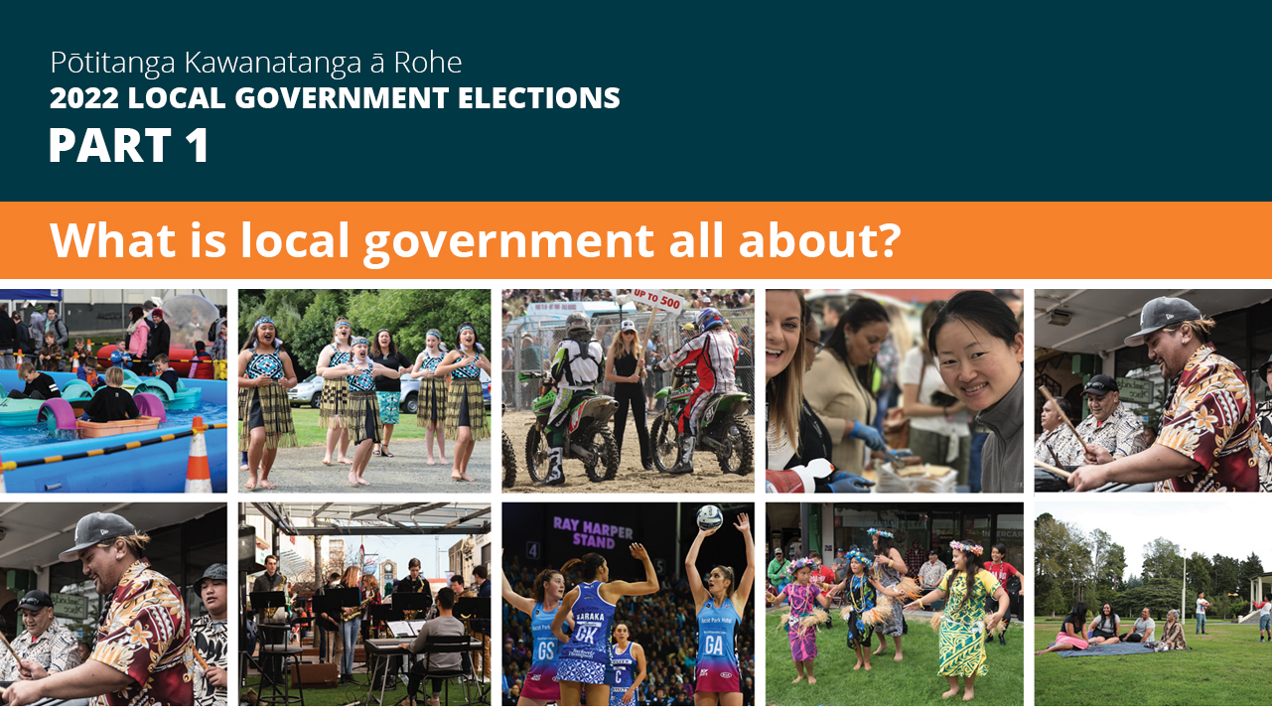

Slide 3
What is local government all about?
1. Community Leadership – dealing with the big issues facing our communities
2. Service Provision – more than 50 different services
It’s a complex business!
Underpinned by more than 125 pieces of legislation, Council is responsible for:
  Formulating the District’s strategic direction in conjunction with the community through the Long Term Plan (LTP) & other key strategies and reporting on progress
  Determining the services and activities to be undertaken by the Council
  Managing regulations and upholding the law, including the formulation and enforcement of bylaws
  Advocating on behalf of the local community with central government, other local authorities and other agencies
  Environmental management through the District Plan
  Ensuring local communities are encouraged to be part of the decision-making processes of local government

Slide 4
What is being an elected member all about?
IT IS A BIG DEAL!
Standing for Council takes a strong commitment, it is not a “5-minute job”
Not to be taken lightly, it is an important responsibility
Represent and lead the district – eyes and ears
Advocacy and governance
Skill set in candidate handbook

Slide 5
Core competencies
Genuine interest for issues faced by local communities
Relate to wide range of people – strong people skills
Competent listening and public speaking skills
Express ideas clearly and be outcomes / results focussed
Understand, analyse and resolve complex issues
Understand governance versus management
Councillor think “district-wide” on issues
Commit to elected members’ Code of Conduct

Slide 6
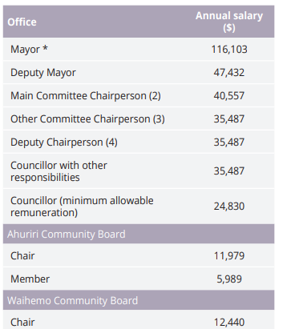
Council meetings & remuneration
Council and Committee meetings are held approximately every 6 weeks
Other subcommittees, taskforce groups, working parties, project steering groups etc. are formed as needed plus workshops and briefings most weeks
Generally mayor is full time job, councillor is between 2 - 4 days per week
A lot of reading of reports and agendas required
Flexible working hours – some evening and weekend work required
Remuneration:

Slide 7


Slide 8

Council meetings/Remuneration: ORC
Schedule for 2019-2022 had two days per fortnight (Wednesday / Thursday). We will be reviewing this and providing advice to the incoming Council.
Council meetings held monthly, mostly in Dunedin, with meetings in the regions (two meetings scheduled for Queenstown in 2019-2022 triennium). Committee meetings quarterly, and workshops/briefings as required.
Remuneration
  Chair: $152,881 (Post 2022-elections)
  Deputy Chair: $91,055 (2019-2022 triennium)
  Councillor: $62,000 (2019-2022 triennium)

Slide 9
Rauemi | Resources
Candidate Handbook and nomination papers
LGNZ 'Making a Stand' booklet
Council’s Pre-election report – available from 1 August 2022:
To inform the community and candidates on key aspects of Council business
To set out major projects and expenditure for next 3 years
To promote discussion on issues and inform any elections debate
Legislation (LEA, LER)
Council's website (for election information):
ORC Pre-election report, candidate handbook and other information available on the website (www.orc.govt.nz)

Slide 10
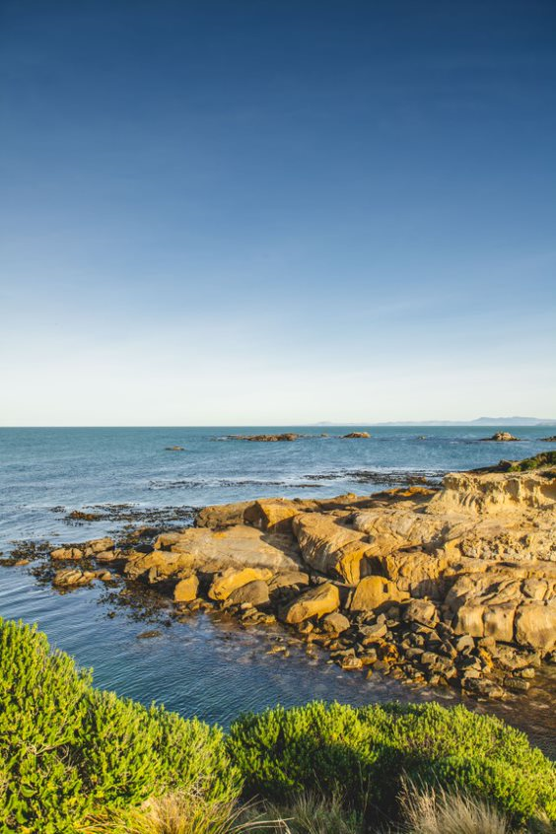
Shag Point

Slide 11
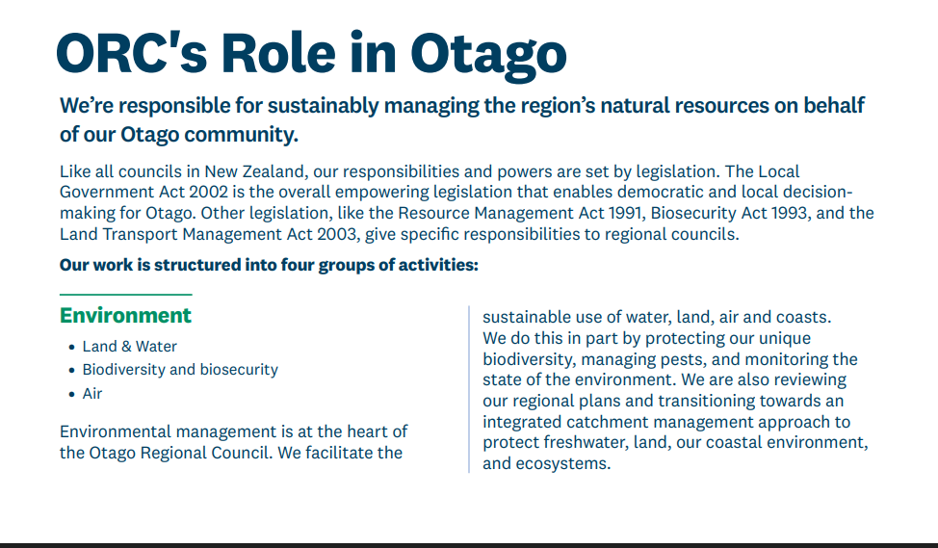

Slide 12
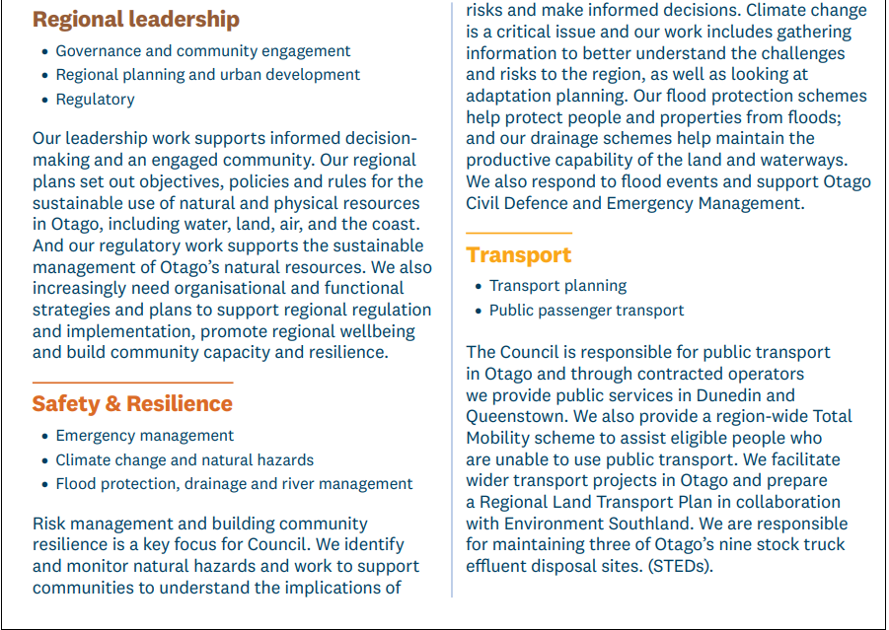

Slide 13
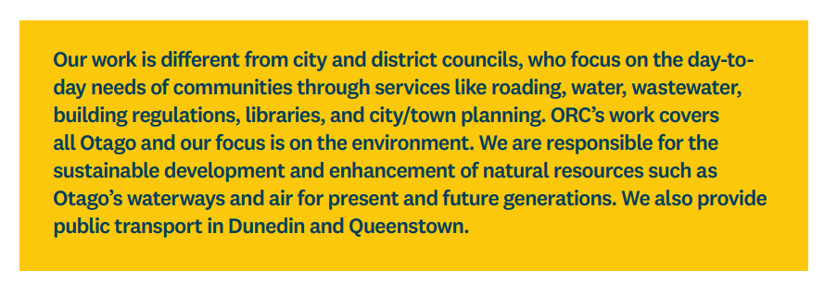

Slide 14


Slide 15
About electionz.com
Election services company based in Ōtautahi, Christchurch
10 full time staff
Average 200 elections in NZ each year
Electoral Officer (EO) for 39 councils, 6 regional councils
Carrying out vote processing for 45 councils, approx 725K returned voting papers
Vote Processing centre in Ōtautahi, Christchurch
Electoral Officer for:
Bay of Plenty, Greater Wellington, Canterbury, Otago, Southland, West Coast
Tauranga, Rotorua, Matamata-Piako, Taupō, Waipā, Ōtorohanga, Waitomo, South Waikato, Ruapehu, Rangītikei, Manawatū, Whanganui, Horowhenua, Napier, Hastings, Central Hawkes Bay, Carterton, Wellington, Masterton, South Wairarapa, Upper Hutt, Nelson, Tasman, Westland, Kaikōura , Kaikōura, Hurunui, Waimakariri, Selwyn, Ashburton, Mackenzie, Waimate, Waitaki, Dunedin, Central Otago, Gore, Southland, Invercargill

Slide 16
Electoral Team
electionz.com Ltd contracted by Waitaki District Council
Anthony Morton - WDC Electoral Officer
    0800 666 048 or waitakidc@electionz.com
Carole Hansen - WDC Deputy Electoral Officer
    (03) 433 0300 or chansen@waitaki.govt.nz

Slide 17
Electoral Officer Role and Responsibilities
The Electoral Officer (EO) is solely responsible for the conduct of the election
The EO is not subject to the directions of any local authority, elected members, or the CE
Provides a level playing field for all candidates
NB Not responsible for monitoring campaigning by candidates. Only deals with alleged breaches of the Act by passing them to the Police.

Slide 18
2022 Election Timetable
Election period begins 8 July (Friday)
Nominations open 15 July (Friday)
Electoral signs can go up 8 August (Monday) – 2 months before election day
Nominations close 12 noon, 12 August (Friday)
Delivery of voting papers 16 – 21 September (Friday-Wednesday)
Special voting period 16 September to 8 October
Close of voting 12 noon, 8 October (Saturday)
Progress results available 8 October, approx 3pm
Removal of election signs midnight 7 October (Friday)
Official declaration likely to be 13 October (Thursday)
Candidate expenses deadline probably 8 December (Thursday)

Slide 19



Nominations required for:
Mayor
Councillors - 10 councillors from 4 wards
Ahuriri Ward 1 councillor
Corriedale Ward 2 councillors
Oamaru Ward 6 councillors
Waihemo Ward 1 councillor
Oamaru Licencing Trust
At Large across Trust Area 5 members
Community Board members
Ahuriri CB 5 members
Waihemo CB 5 members
Otago Regional Council
Moeraki Constituency 1 member

Slide 20
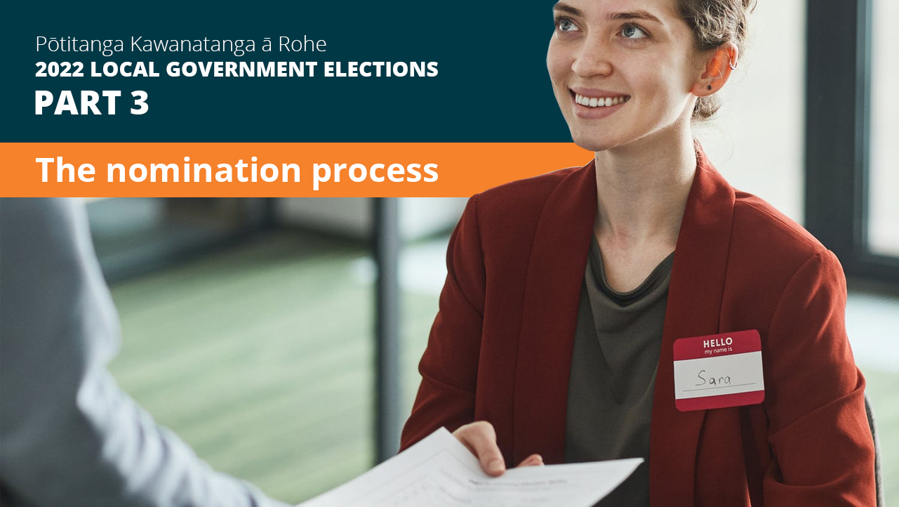

Slide 21
Nomination Process
Open Friday 15 July and close midday Friday 12 August (4 weeks)
Documents to submit:
  nomination form
  evidence of $200 deposit
  evidence of NZ citizenship
  profile statement (optional)
  photo (optional)
Forms available from WDC offices or WDC website
Can be lodged at WDC Oamaru office or emailed to chansen@waitaki.govt.nz
Nomination deposit can be paid online or in cash

Slide 22
Candidate Eligibility
CANNOT:
Be serving a prison sentence of three or more years
Stand for Otago or Canterbury Regional Councils and WDC
Have interest in a contract over $25K per year with council without OAG approval
Nominate yourself
CAN STAND:
For both mayor and/or councillor and/or community board
If you live outside area, but must state that on nom paper (not Oamaru LT)
If a council employee but must resign if elected as mayor or councillor
CANDIDATE MUST:
Be a NZ citizen and enrolled on parliamentary electoral roll
Be nominated by 2 electors who are enrolled for the electoral issue the candidate is standing for
Provide all nomination documents together
CAN’T WITHDRAW AFTER NOMINATIONS CLOSE

Slide 23
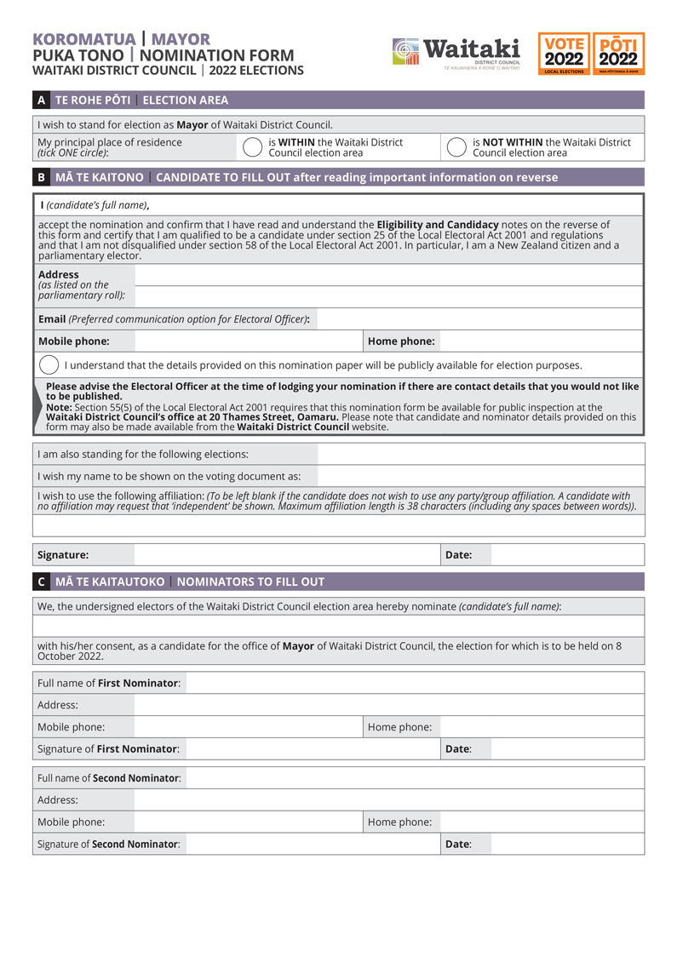
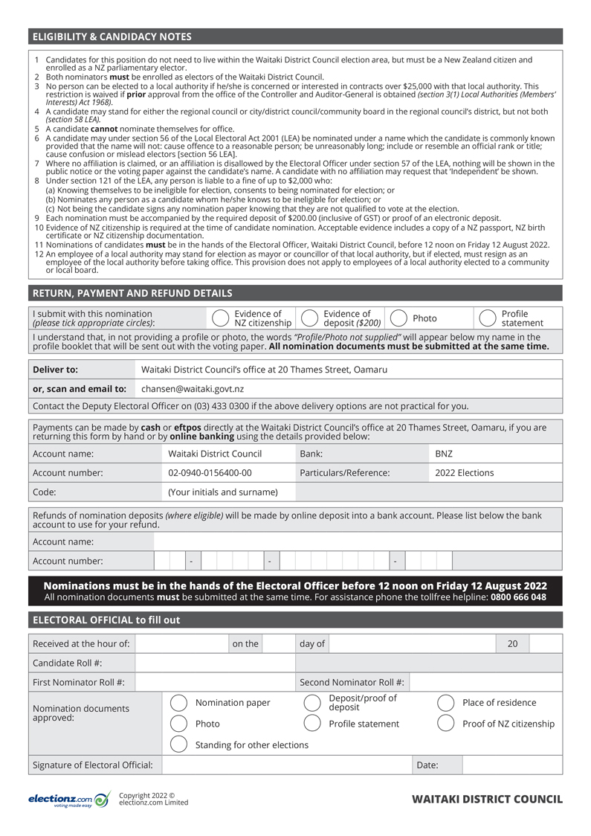

Slide 24
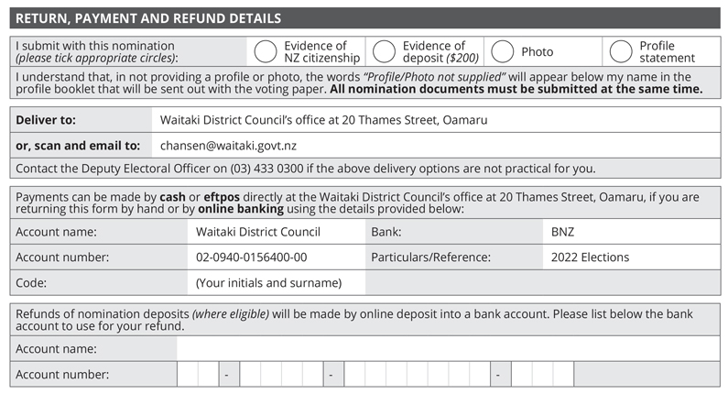

Slide 25
Candidate Profile Statements and Photos
Profiles
May be provided (not mandatory) – see page 18 of handbook
Must be provided electronically with the other nomination documents as a MS Word doc, not a pdf, not hand-written
Up to 150 words about the candidate, their policies and intentions
Cannot comment on policies etc of any other candidate
Can be emailed to the DEO but hard copies must be attached to nom form if hand delivering
Profiles on council website as soon as ready after close of nominations
Photos
Photos in colour, within last 12 months, head and shoulders shot only (no hats, sunglasses, children, pets or friends)
Should be provided electronically with the other nomination documents as jpgs
Should be against light coloured background (not a window)

Slide 26
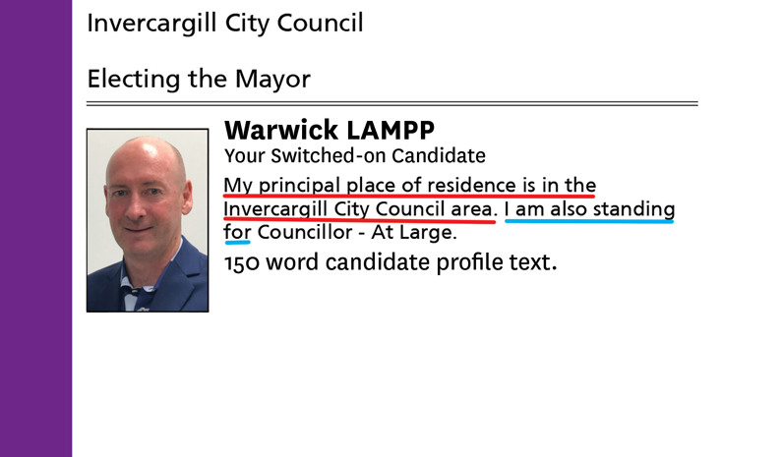
Example Profile Statement
Auto-populated text
Hard-coded text

Slide 27


Slide 28
Campaigning
Can commence any time
  Can’t use council resources for campaigning (logo, branding, colours, council FB or twitter feed, photos, council buildings etc)
  Voting papers should not be collected from electors by candidates or their assistants
  No campaigning or electioneering in council chambers or on council premises
Election expenses for campaigning must be recorded and declared in a return after the election
Any campaign material (signs, posters, billboards, flyers, ads, cars, social media) must have an authorisation from the candidate or their agent, stating their name and contact details
  Can be address, mobile, email, PO Box
  Should be on the front of the sign or promotional material (not the back)
Must be factual
Usual rules of defamation apply

Slide 29
Election Expenditure Limits
Waitaki District Council
Mayor $20,000
Ahuriri Ward $ 3,500
Corriedale Ward $ 3,500
Oamaru Ward $14,000
Waihemo Ward $ 3,500
Ahuriri Community Board $ 3,500
Waihemo Community Board $ 3,500
Oamaru Licensing Trust
Members (whole area) $20,000
Otago Regional Council
Moeraki Constituency $20,000

Slide 30
Election Expenses
See pages 22 and 41 of the handbook
If standing for more than one position the single limit applies
Declaration period starts 3 months before election day - 8 July 2022
Must pro-rata expenses for activity outside the 3 months
Declaration listing summary of electoral expenses and electoral donations required within 55 days after the official result declaration – about 8 December
Includes Nil declarations
Deposit not refunded until the return is completed (provided candidate gets more than 25% of the votes of the lowest successful candidate)
Electoral expenses and donation declarations are public documents (council website)

Slide 31
Electoral Donations
See page 22 of the handbook
$1500 level but recommend all donations be recorded
Donations over $1500 must be included in candidate declaration
Rules around “anonymous” donations. Can’t be anonymous if you know who it has come from
An anonymous donation cannot be over $1,500
It is an offence to circumvent $1,500 limit, i.e. by deliberately splitting up a donation into smaller contributions
  Donations over $1500 made up of contributions (e.g. via a trust) is treated as one donation and all contributors need to be disclosed.

Slide 32
Election Signs
See page 26 of candidate handbook
Election signs can go up from Monday 8 August (2 months prior to election day)
Must comply with council hoardings policy re size and placement
Must have authorisation statement
Can’t include copy of voting paper
Can be on private land, with owner’s permission
One sign per candidate per site
NZTA rules apply for State Highways, see page 22
Vehicle signwriting is ok – cost of running a vehicle if it is own personal transport is not an election expense
Complaints about size and placement made to council’s Enforcement Officers – not the EO or DEO
Signs to be removed by midnight 7 October

Slide 33
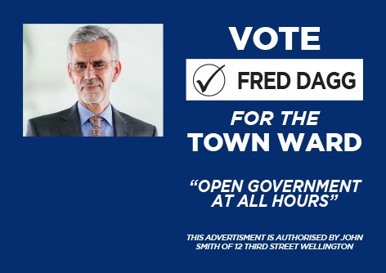
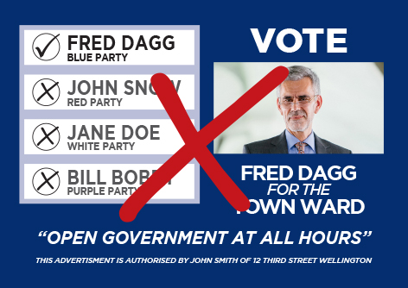
Election Signs – Good and Bad

Slide 34
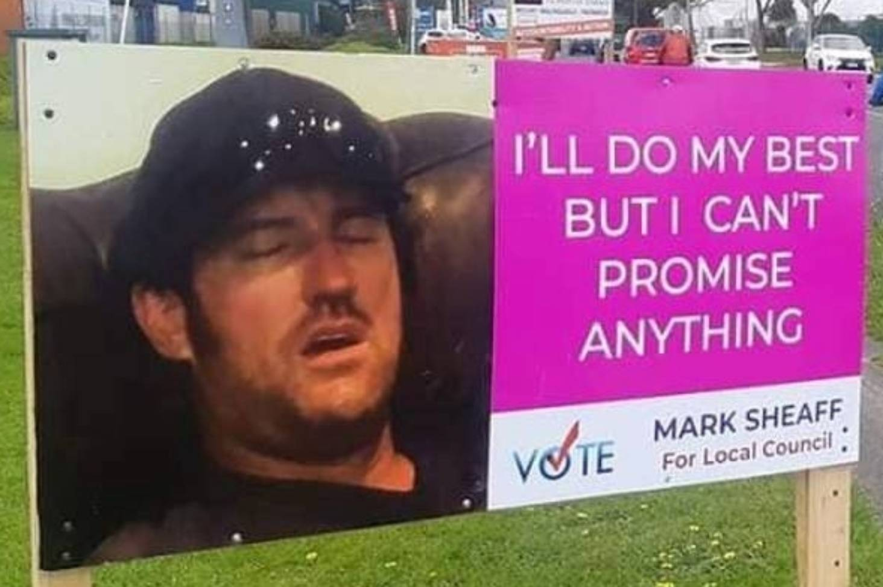
Election Signs – Too honest??

Slide 35
Social Media
During the three-month election period:
Council’s social media channels will unlike / unfollow all candidate social media channels
Candidates must not link their own social media channels (if they are used for campaigning purposes) to the Council’s social media channels,
Candidates must ensure they have the appropriate authorisation on their social media channels
Council social media channels cannot be used for electioneering by candidates or members of the public – will be monitored and any campaign posts removed

Slide 36
Election Offences
See page 48 of handbook
Imitation Voting Papers
Bribery
Treating
  Can’t provide food, alcohol, drinks, entertainment as an inducement to vote (light refreshments after a meeting is ok)
  Can’t give away tee shirts, bags, pens, note pads, fridge magnets (items of value) etc
Undue Influence – cant stand over someone telling them how to vote, or post or deliver someone else's voting paper or display a copy of your completed voting paper
Unauthorised advertisements
Any formal complaint passed to the Police

Slide 37
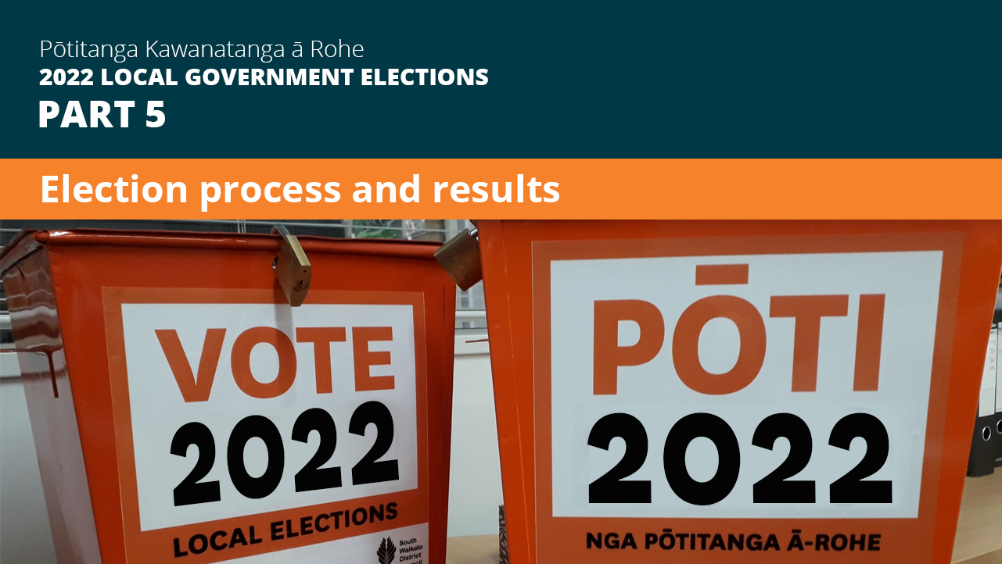

Slide 38
Electoral Rolls
Preliminary Electoral Roll
available for public inspection from 15 July to 5pm Friday 12 August 2022
at WDC offices/libraries
includes the ratepayer roll
cannot be provided electronically to candidates
can purchase hard copy for $35 per Ward or $100 full roll (plus GST)
Final Electoral Roll
produced mid September
is the roll used for issuing voting papers
can purchase hard copy as above
Confirmed candidates can apply to Electoral Commission to purchase electronic file ($455.50 fee applies). See P 12 of handbook.

Slide 39
Voting Process
Postal voting only. No early voting option available
Voter packs lodged with NZ Post Thursday 15 September
Deliveries from 16 September
Closes 12 noon on election day, 8 October 2022
Special voting available at the WDC Oamaru office, or can be posted out to applicants (if time allows)
Applicants can come in or contact DEO by phone or email
Candidates should not collect voting documents on behalf of electors

Slide 40
Election Results
Preliminary count occurs from 12 noon, Saturday 8 October 2022
Progress results: expected about 2pm – approx 95% of votes received (not special votes and votes in transit to processing centre).
Progress results:
Will be available from council’s website
emailed to all candidates with email address
Preliminary results: expected late on Sunday 9 October, after all ordinary votes have been processed
Final results: expected by Thursday 13 October, after special votes have been processed

Slide 41
Coming into Office
All members come into office on the day following the day on which the candidates are declared to be elected
This is the day after the result declaration is posted on council’s website - expected to be Friday 18 or Saturday 19 October
Successful candidates contacted by mayor/staff
Council’s inaugural meeting and the “swearing in” of elected members will be held at end of October date to be confirmed (elected candidates cannot act until this has occurred)

Slide 42
Resources
Candidate handbook, nomination forms and council website
LGNZ 'Making a Stand' booklet
Council’s Pre-election report – available from 15 July 2022:
To inform the community and candidates on key aspects of Council business
To set out major projects and expenditure for next 3 years
To promote discussion on issues and inform any elections debate
Legislation (LEA, LER)

Slide 43
Last words
No DHB elections this time
Get your nominations in early
Campaigning – stick to your own promotions
Authorisation statements on all campaigning material
Election results – on websites/email – progress/prelim/final
Election day – Saturday 8 October 2022
Good luck all!!

